Slide 1
Search for Luminosity Indicators

Slide 2
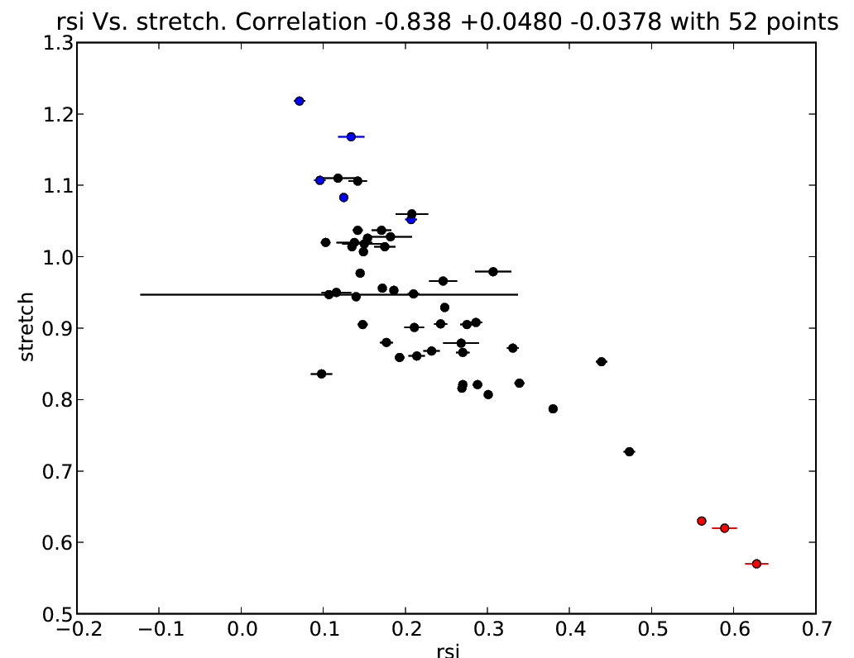
R(Si) and Stretch

Slide 3
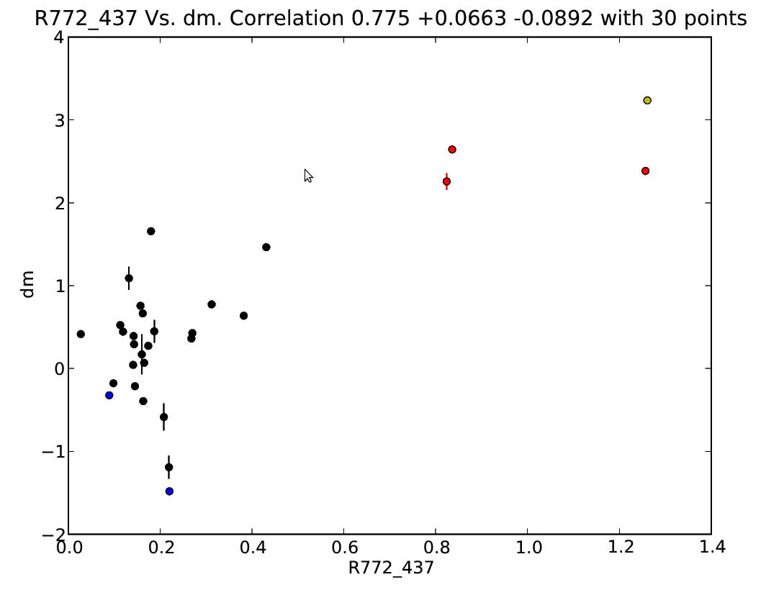
Factory Ratio and dMag

Slide 4
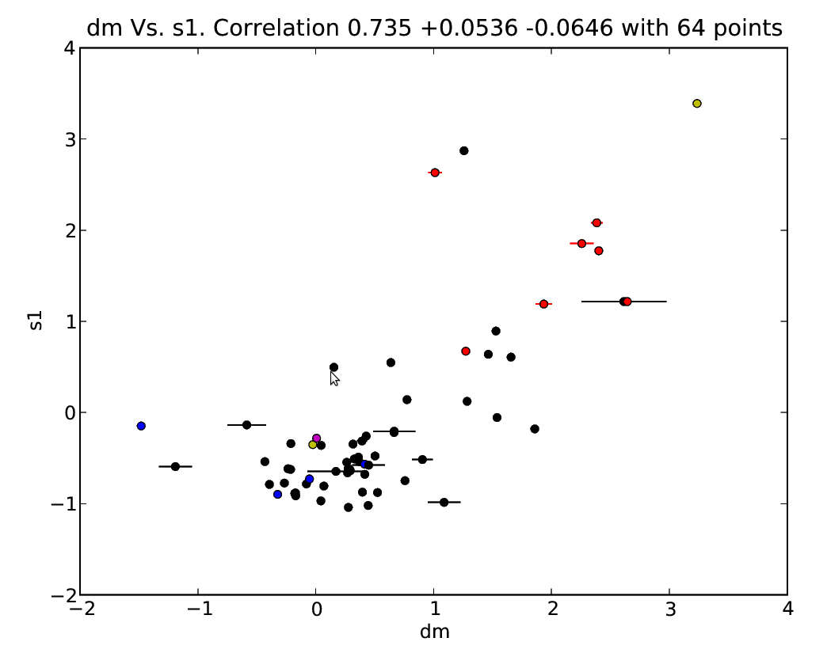
PCA Component 1 and dMag

Slide 5
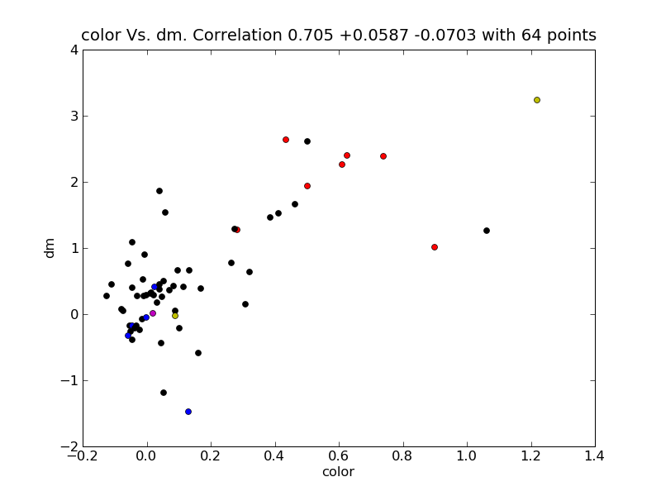
Color and dMag

Slide 6
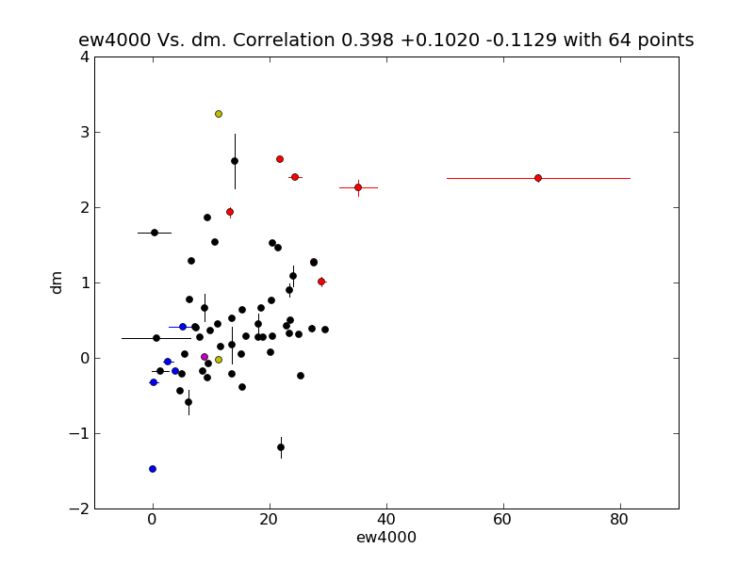
Si 4000 and Color

Slide 7
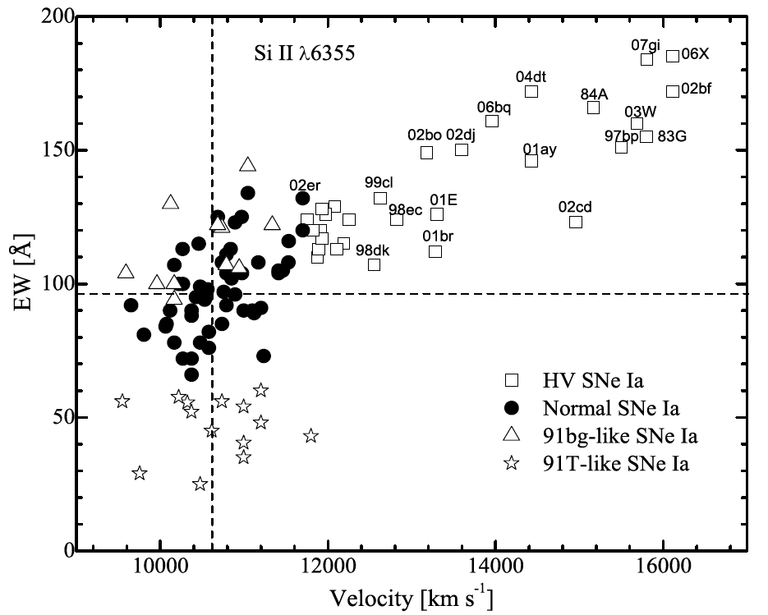
Wang et al.

Slide 8
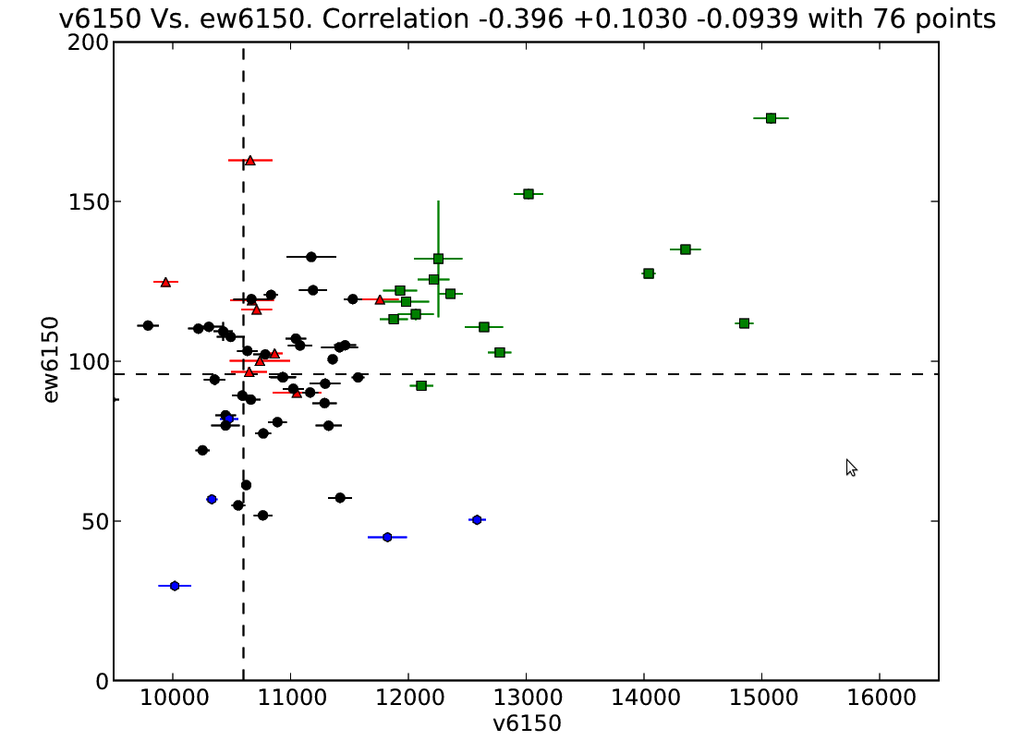
Wang et al.

Slide 9
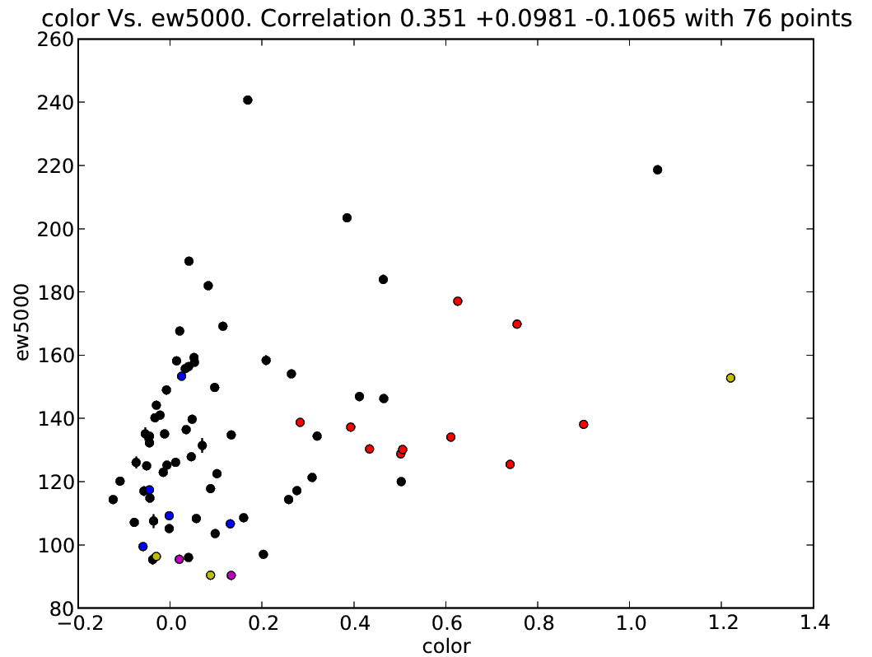
FeII and Color

Slide 10
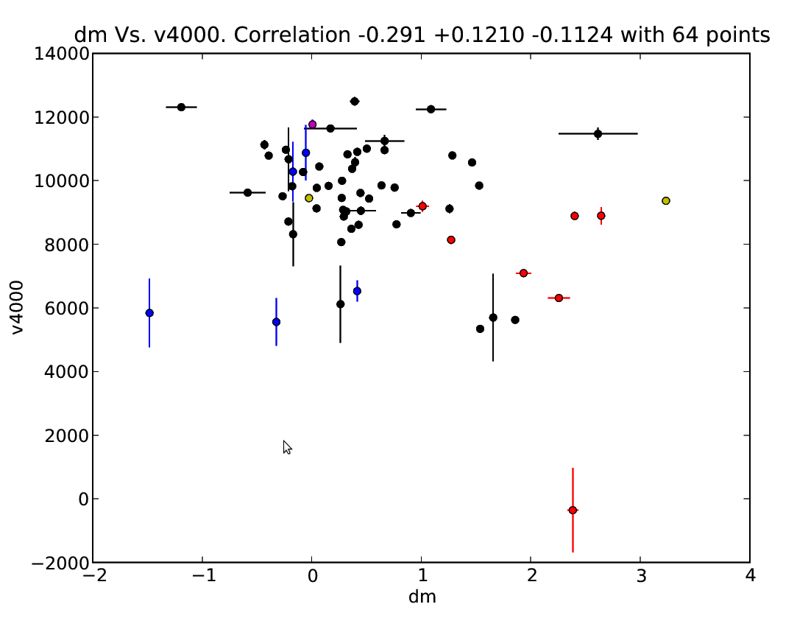
Velocity of Si and Color

Slide 11
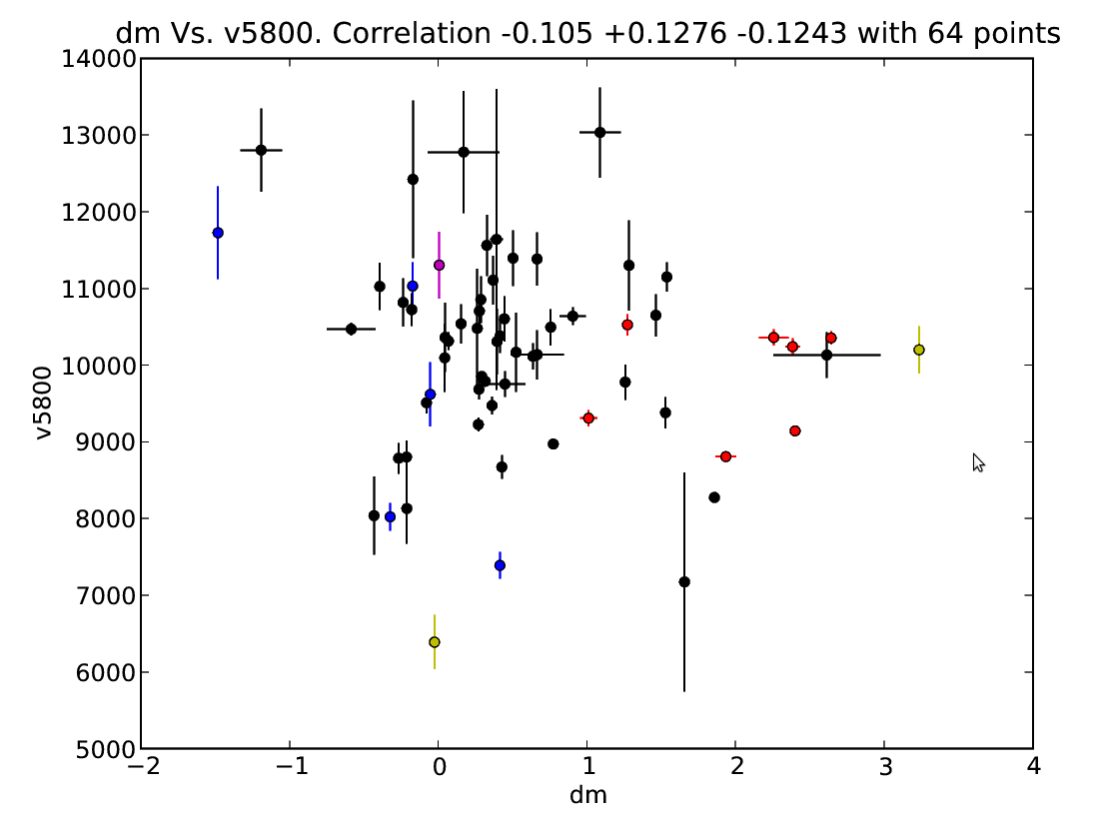
Velocity of Si and Color

Slide 12
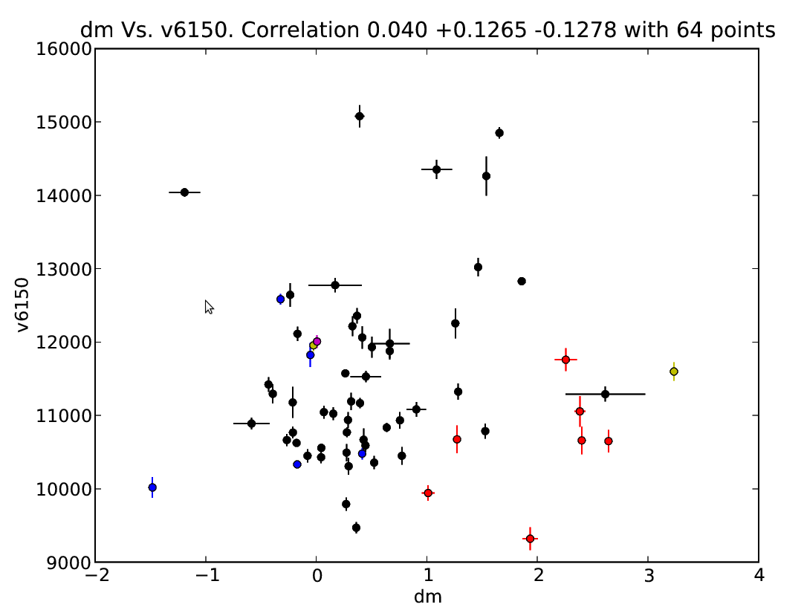
Velocity of Si and Color

